Slide 1
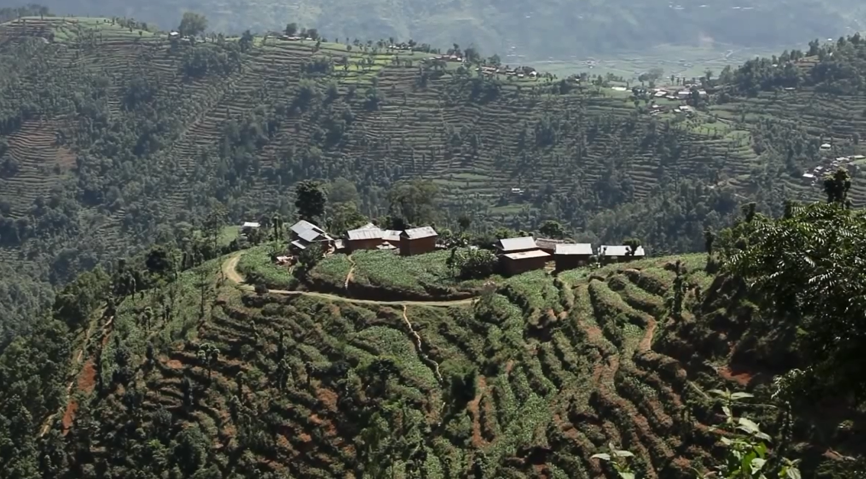
In April and May of 2015, two huge earthquakes struck Nepal…..

Slide 2
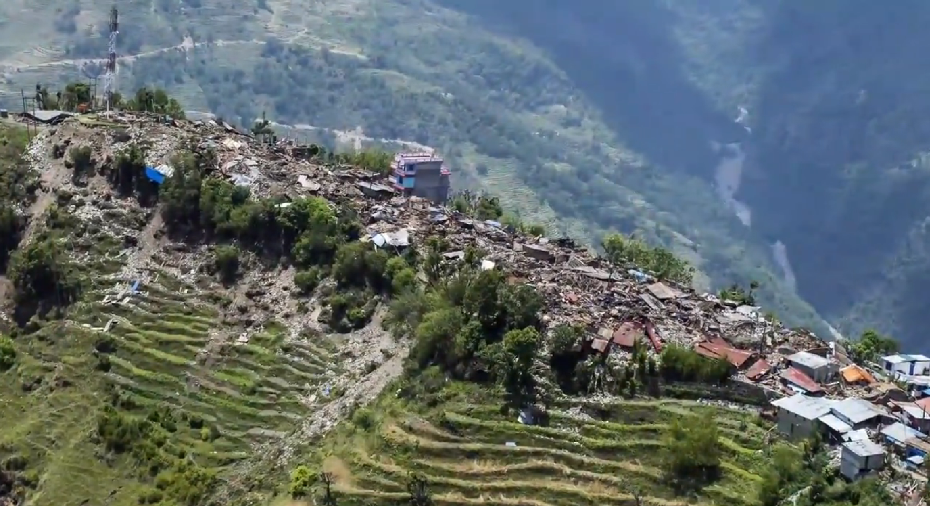
14 districts were severely hit,
affecting the lives of
9.1 million people

Slide 3
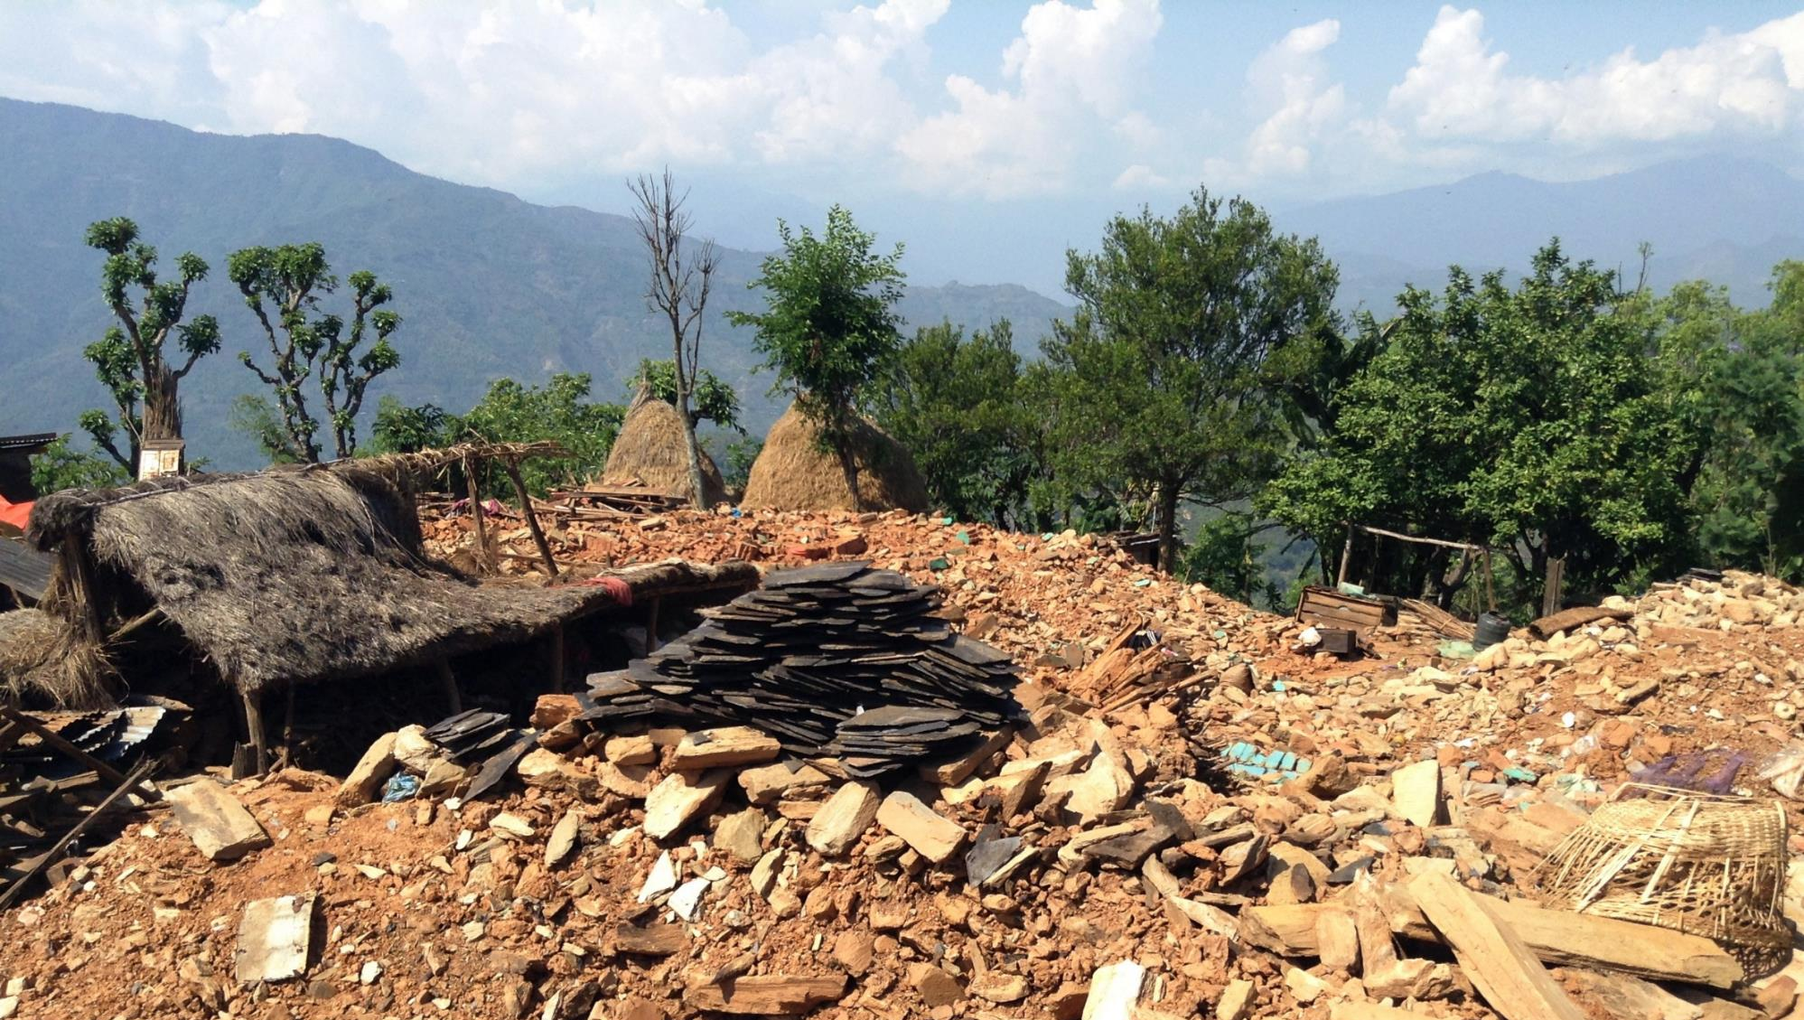
In a matter of seconds,
490,000 houses were destroyed…
IMAGE

Slide 4
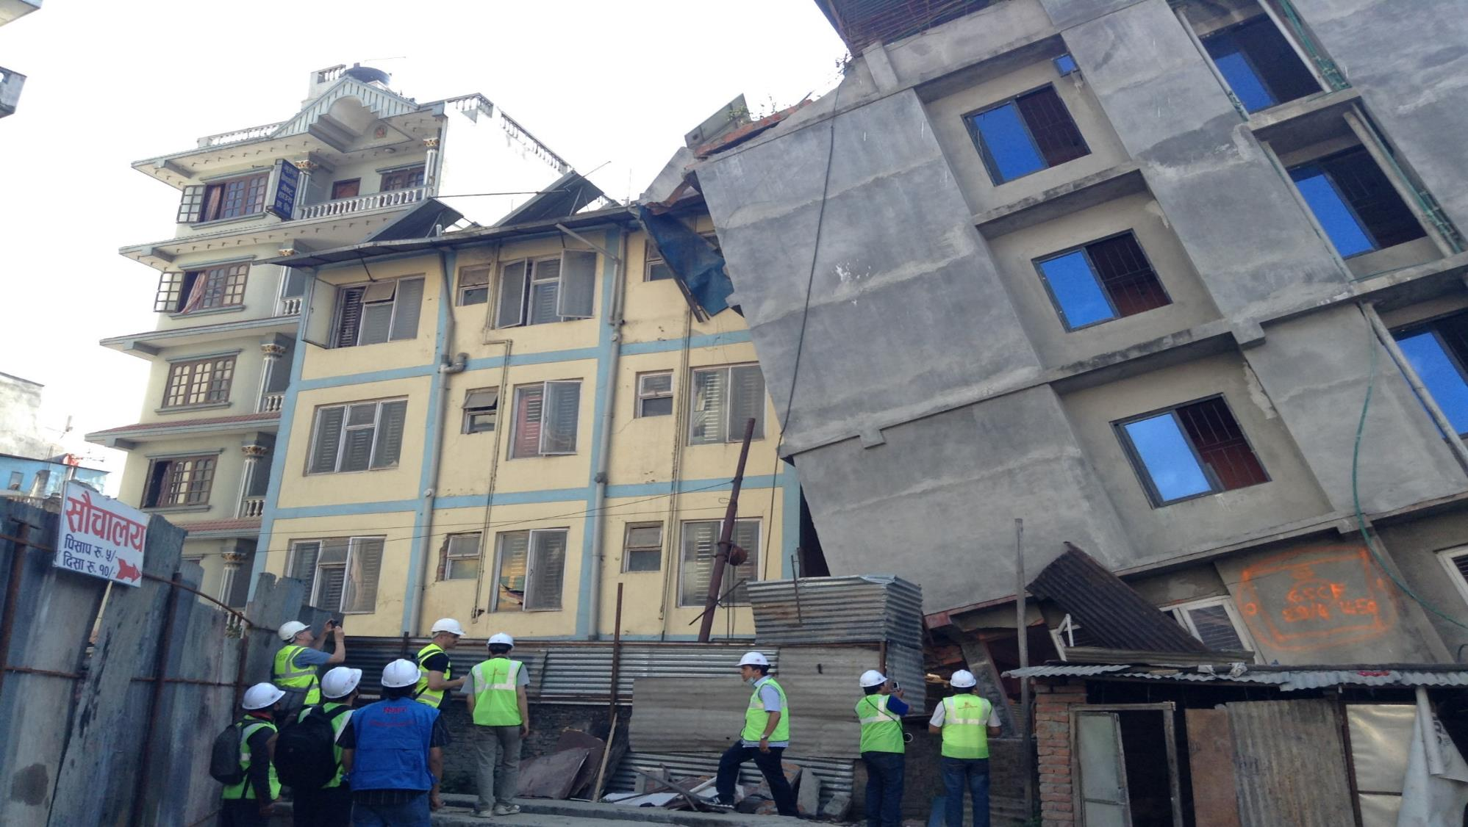
… and another 265,000 houses
were left uninhabitable
IMAGE

Slide 5
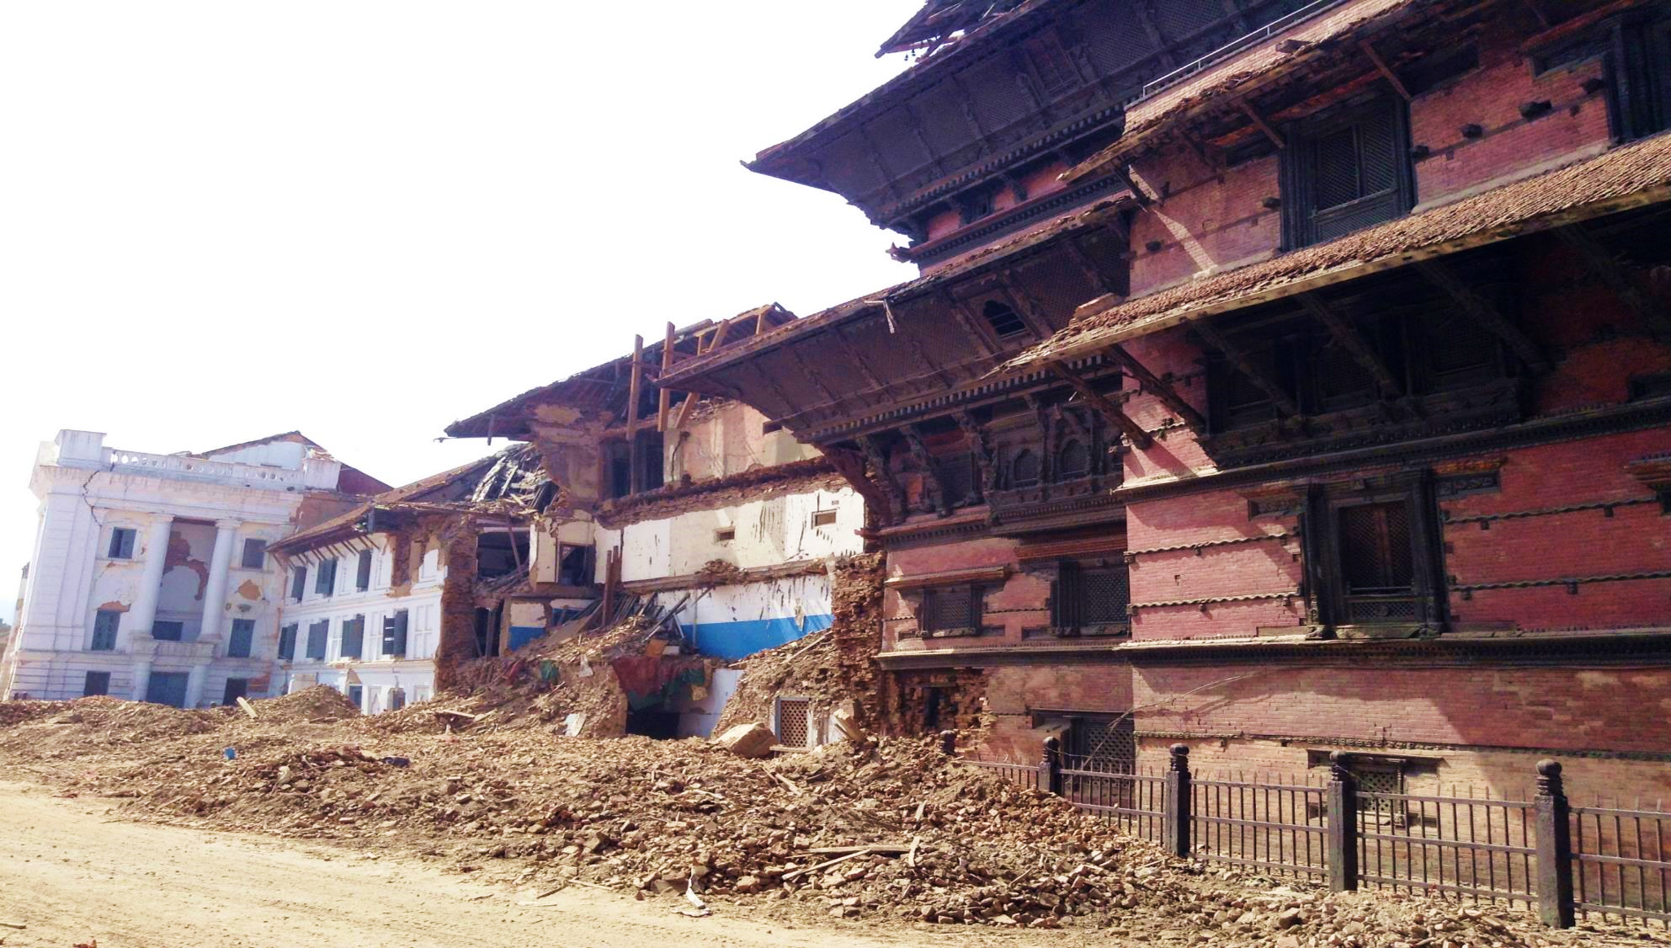
Material losses are calculated
at about US$7.1 billion
The human pain and personal losses
are impossible to calculate

Slide 6
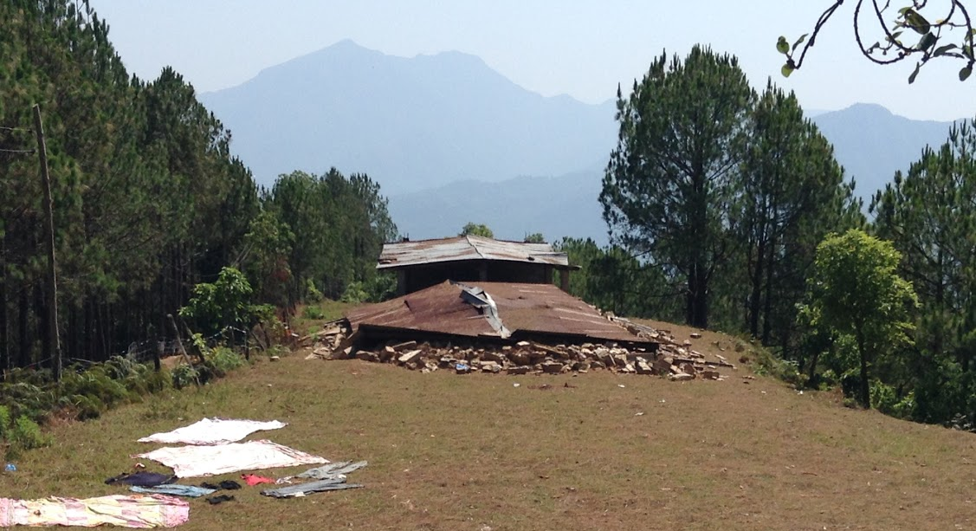
In the disaster, close to
9,000 people lost their lives and 22,000 were injured…

Slide 7
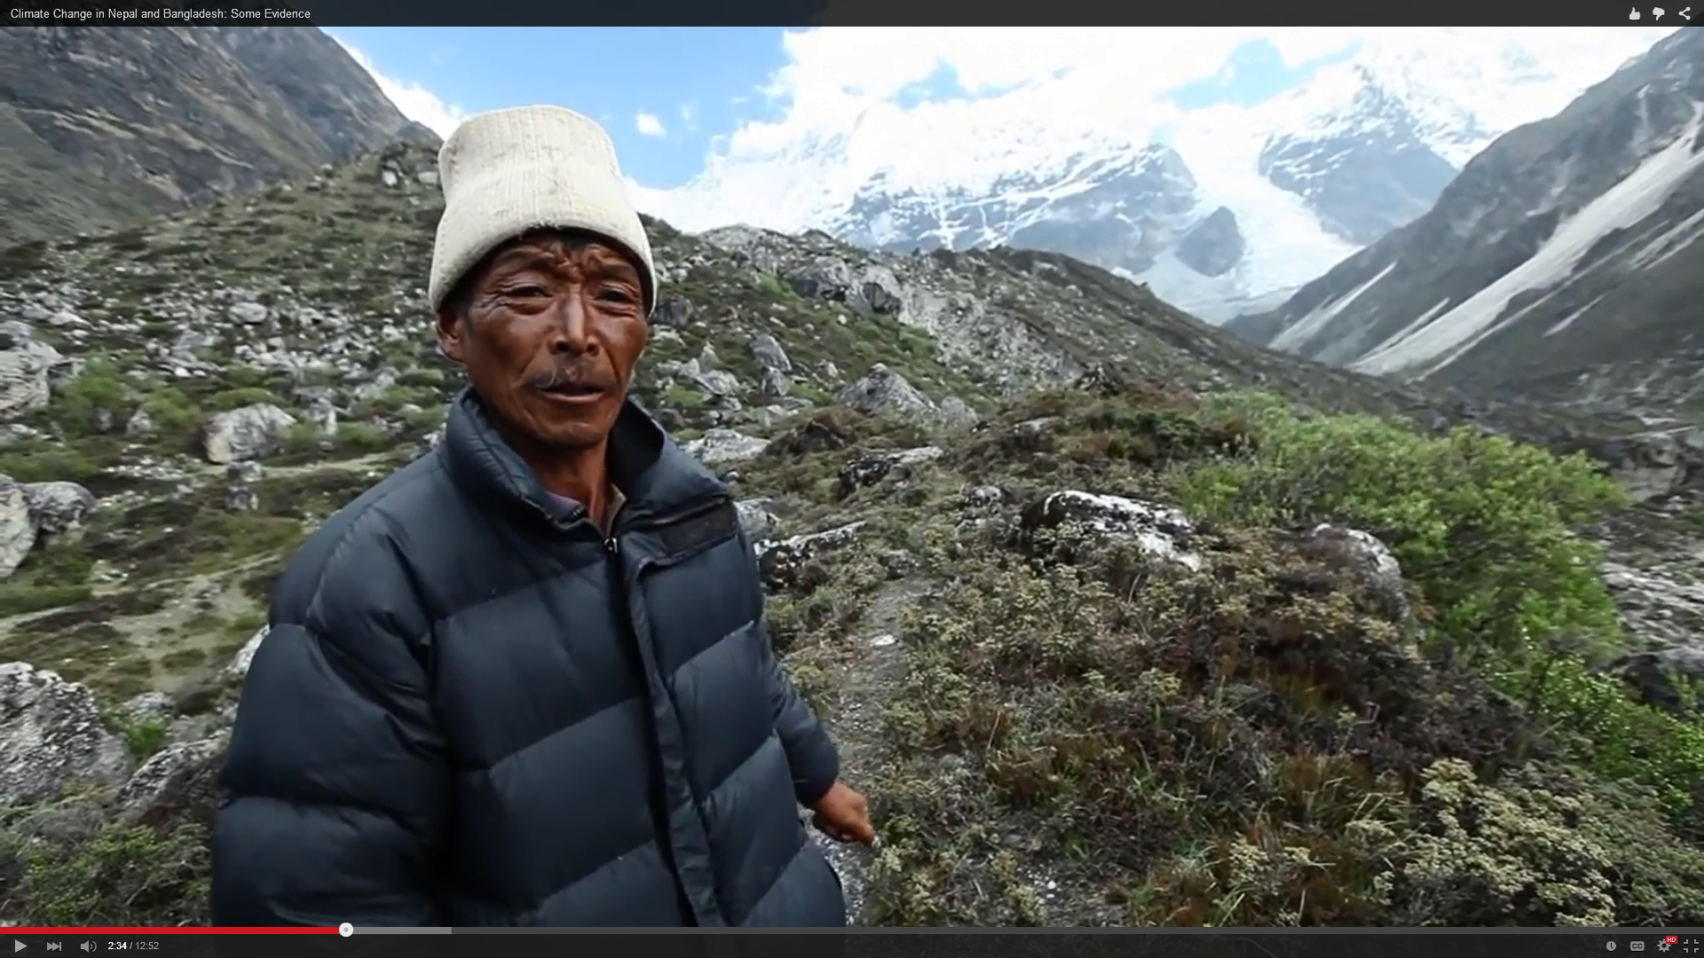
The earthquakes also triggered
extensive landslides and avalanches
causing further damage as well as
the disruption in essential services
The immediate impact on poverty, livelihoods and output is likely to be severe

Slide 8
“Housing reconstruction and human settlements” is the largest single need, accounting for US$3.27 billion, or almost half of the total reconstruction needs

Slide 9
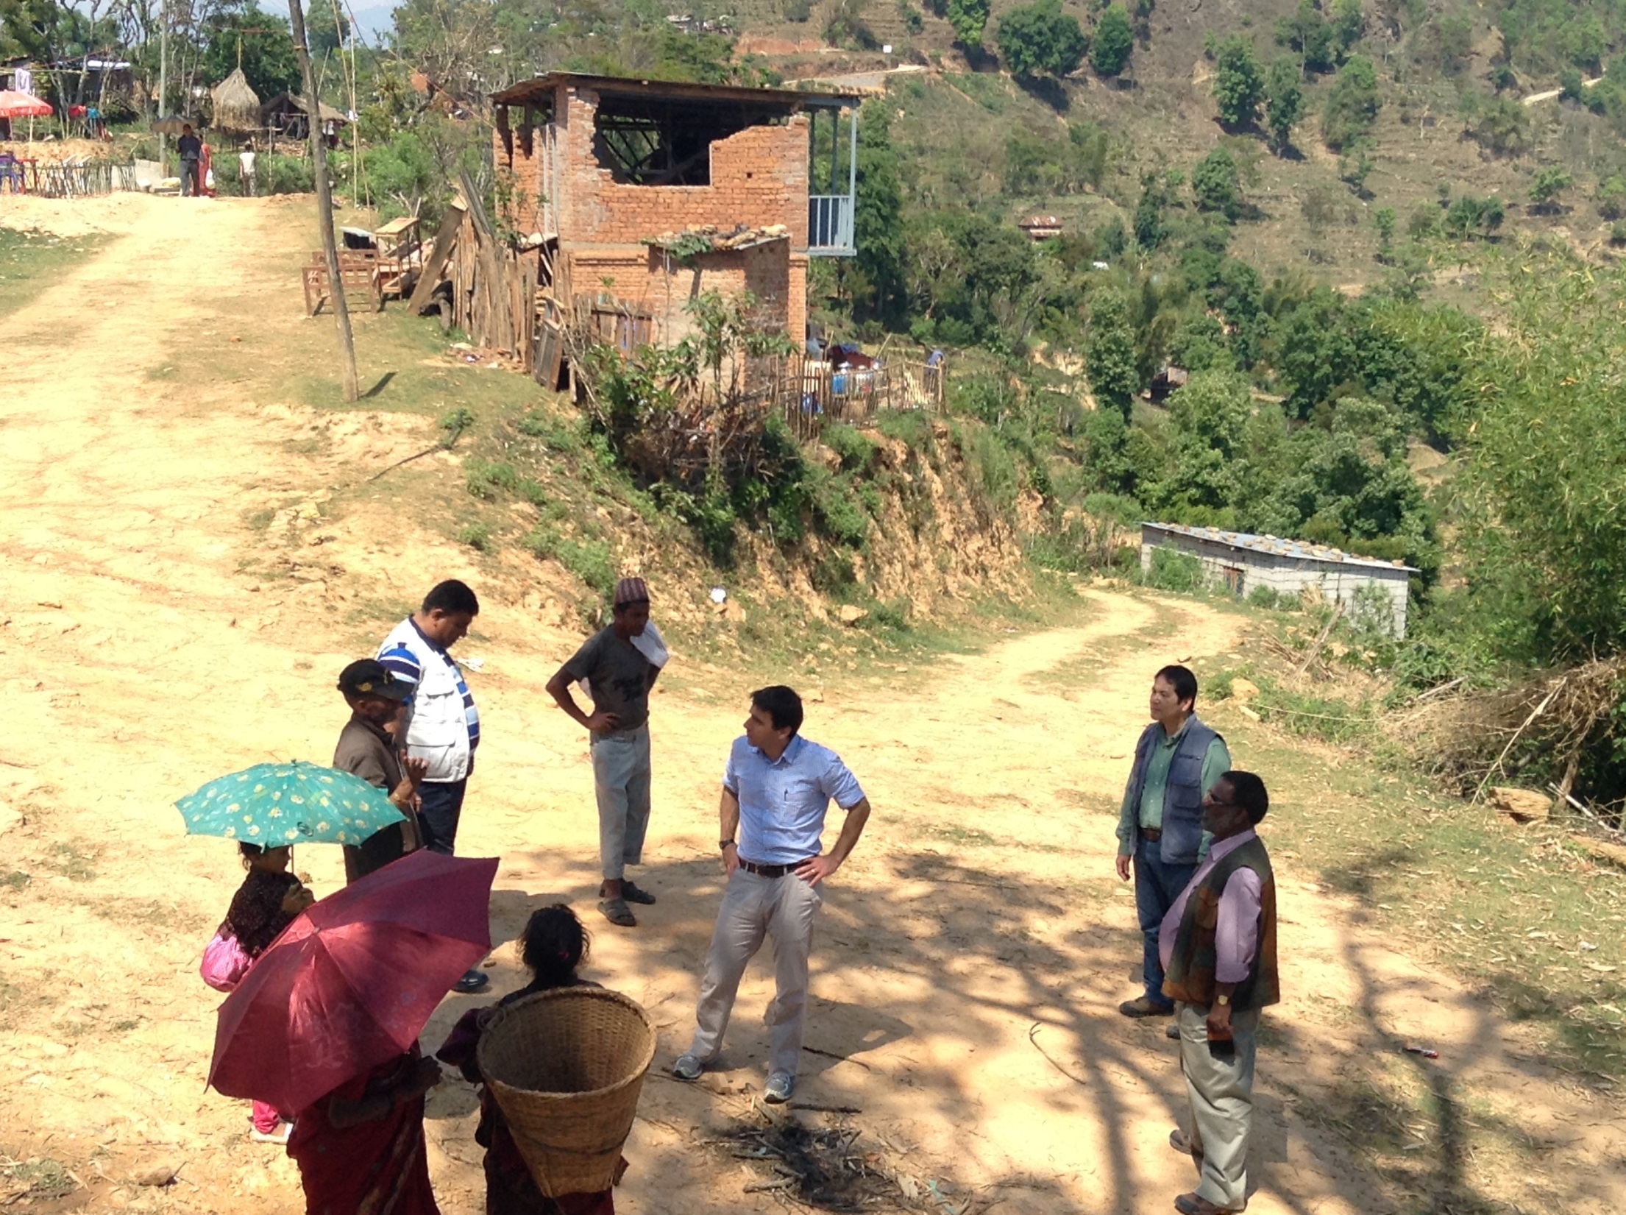
To build a more resilient Nepal,
the Government of Nepal
is leading a housing reconstruction program that provides a coordinating
framework to standardize reconstruction norms,
irrespective of the funding sources

Slide 10
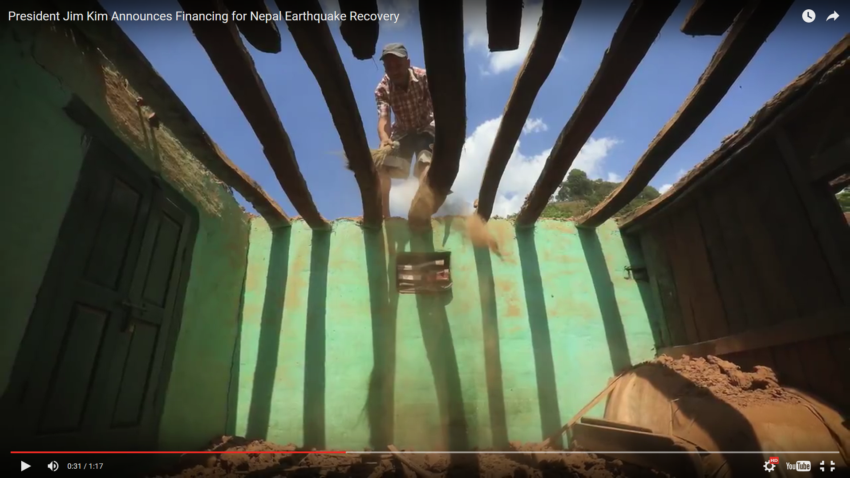
To support the Government of Nepal’s
housing reconstruction efforts in rural areas,
a Multi-Donor Trust Fund
has been established with support from
USAID, the Swiss Agency for Development and Cooperation, the Government of Canada and the World Bank

Slide 11
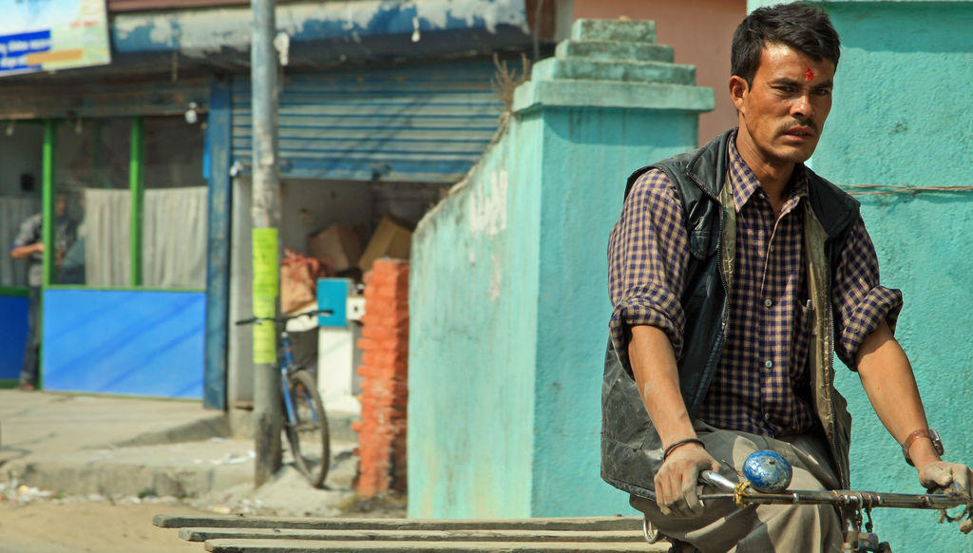
The Nepal Earthquake Housing Reconstruction Program is focused on restoring damaged and destroyed housing in 14 targeted districts, mostly rural,while providing technical support to enhance and improve long-term disaster resilience

Slide 12
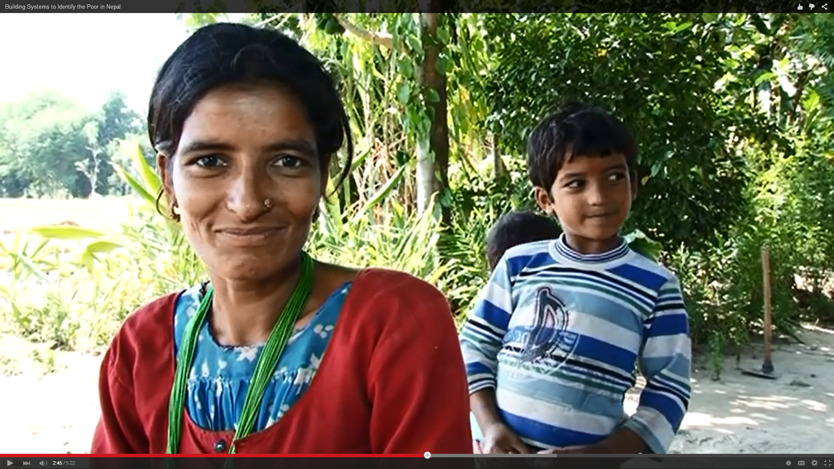
Together, Nepal is rebuilding…
with more resilience

Slide 13
This material has been funded through the Nepal Rural Housing Reconstruction Program, thanks to the contributions of: US Agency for International Development (USAID), Swiss Agency for Development and Cooperation (SDC), the Government of Canada and the World Bank. The views expressed do not necessarily reflect the Canadian, US or Swiss government’s official policies or the policies of the World Bank and its Board of Executive Directors.
Funded by:
Administered by:
South Asia Region

